Slide 1
Enhancement to Risk and Uncertainty Framework to Consider Flexible Work Arrangements and Overnight Visitors
Bishoy Kelleny, Ph.D.
Modeling Consultant
Joel Freedman
Principal
September 14^{th, 2025}

Slide 2
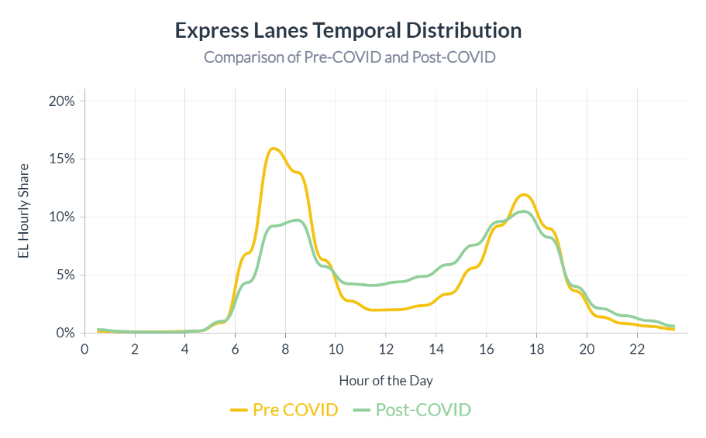




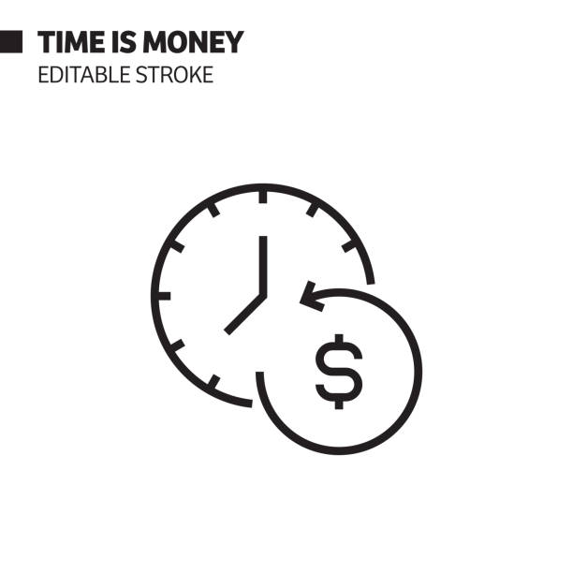

Introduction & Background
Post-COVID shifts (flexible work, overnight visitors) demand enhanced frameworks
Travel Forecasting models rely on assumptions about value of time, land use, and networks
Conventional methods of R&U analysis require thousands of runs → computationally infeasible
Uncertainty in forecasts affects revenue, feasibility, and planning of tolled/managed lanes
Source: Florida Turnpike Enterprise (FTE)
Notes:
Introduction & Background
The Challenge of Uncertainty
Travel demand forecasts are critical for toll roads and managed lanes.
Traditional models face uncertainty in:
Traveler value of time
Land use assumptions
Future network conditions
These uncertainties directly affect revenue projections, feasibility, and long-term planning.
Limitations of Conventional Methods
Addressing uncertainty usually requires tens of thousands of full model runs.
Computationally prohibitive with today’s complex, tour-based models.
Why Enhancements Are Needed
Travel behavior has shifted post-COVID:
Flexible work arrangements (remote, hybrid, telecommuting).
Visitor and overnight travel patterns with greater variability.
These new dynamics must be reflected in risk and uncertainty frameworks to produce reliable forecasts.

Slide 3
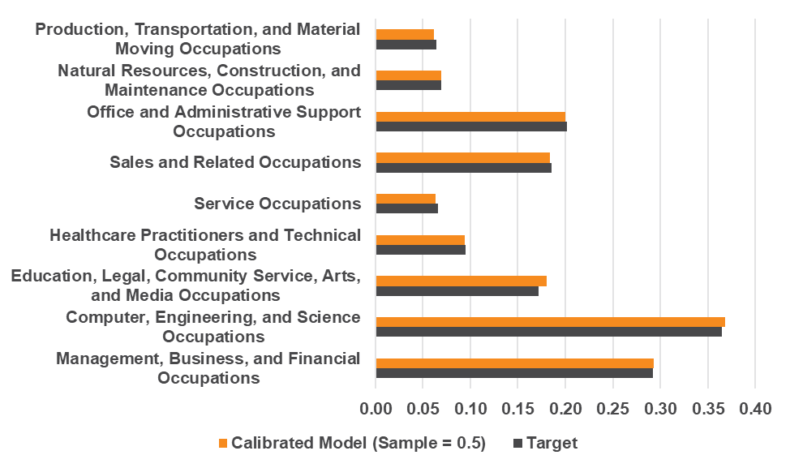
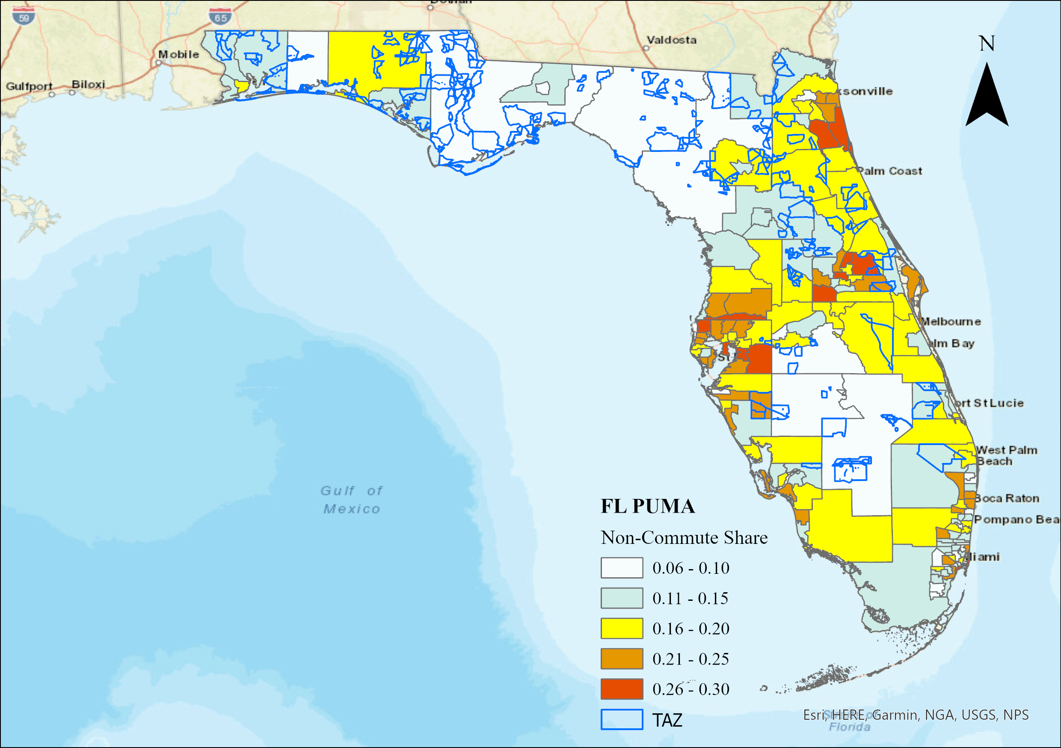
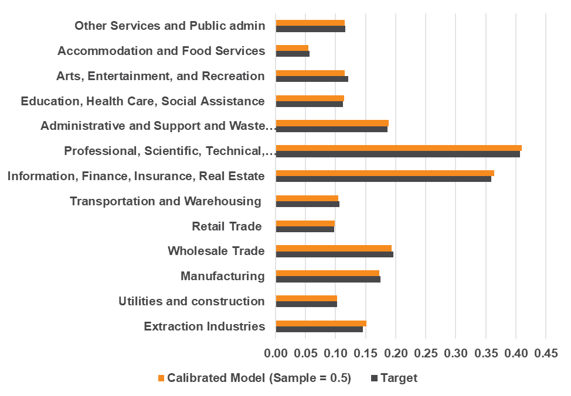
Modeling Enhancement I: Flexible Work Arrangements
Key variables: Income, age, occupation/industry, accessibility
Population Synthesis modified to add occupation and industry controls
Target: 16% of all Florida workers “usually worked from home” in 2023 according to Census – up from 7% in 2019

Slide 4
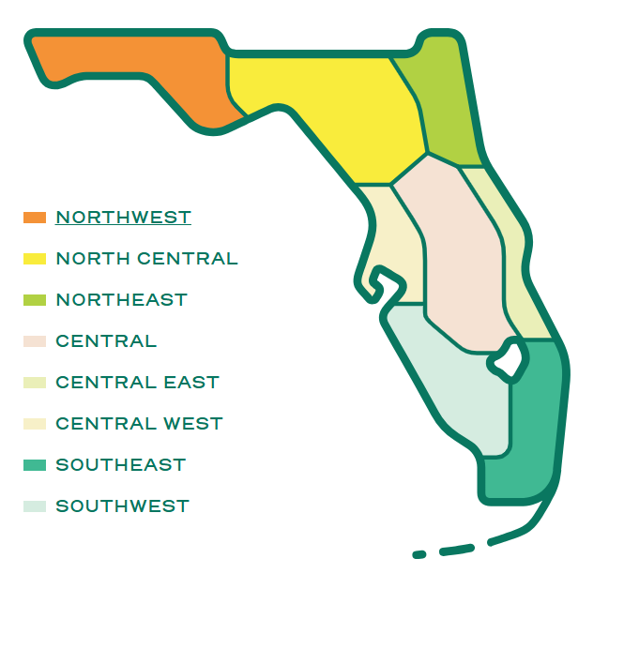



Modeling Enhancement II: Overnight Visitors
Visitor demand inputs updated: shifted from accommodations employment to hotel rooms + short-term rentals with DMA-specific occupancy rates
Region-specific visitor profiles developed (party size, recreation vs. business share) using latest survey data
Auto availability refined: distinguish visitors arriving with their own vehicle vs. renters, by district, improving mode and vehicle type choice modeling
Data source: Latest Orlando International Airport (OIA) survey, courtesy of FDOT District 5
VisitFlorida Designated Market Areas

Slide 5
Risk and Uncertainty Framework
Overview, Key Drivers, Model Integration and Results Interpretations

Slide 6
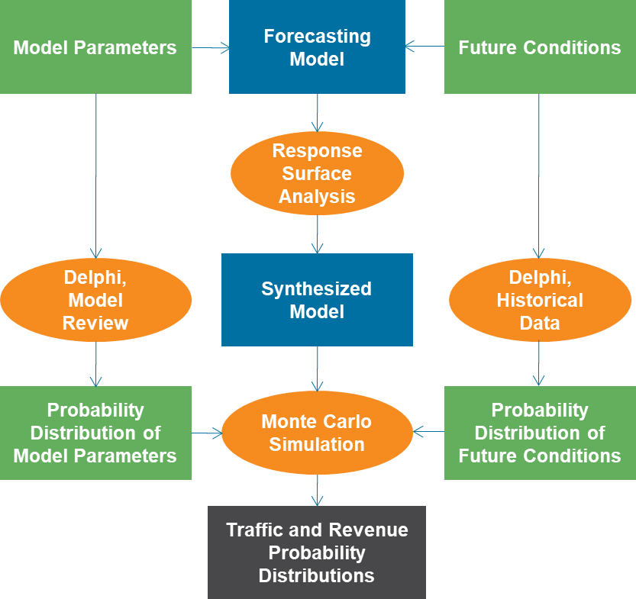

Rationale and Overview
Modeling Integration Overview
For financial feasibility assessments, uncertainty in model forecasts can translate directly into risks of failing to meet project objectives. Our framework addresses this need by providing a systematic way to quantify and manage those risks, supporting more reliable investment decisions.

Slide 7

Key Drivers of Risk & Uncertainty
Value of Time (VOT)
Variation in willingness to pay for time savings
Non-Commute Share
Visitor Occupancy Rates
Population and Employment
Future of the non-commute share trend: continue, stabilize, or decline?
What if macroeconomic shifts or external shocks occur—how would demand respond to fluctuating occupancy rates?
How variability in growth scenarios and development patterns influencing population and employment distribution..
Network Investment
Future infrastructure investments and their impacts on accessibility and route choice.
Accounting for the impact of each key driver on travel demand would require running hundreds or even thousands of full model simulations, creating a heavy computational burden.

Slide 8
Experimental Design I: Model Integration
VOT & Network Investment
Non-commute Share
Visitor Occupancy Rates
Population + Employment
VOT reflects travelers’ willingness to pay for time savings (tested at –50%, –25%, +25%, +50% around $19.83/hr).
Network investment scenarios—Low (existing + committed projects), Medium (cost-feasible LRTP projects), and High (full LRTP build-out)—represent different levels of future infrastructure supply.
Together, they determine accessibility, congestion levels, and route or toll facility choice, as higher VOT travelers respond more strongly to the travel time benefits of greater investment.
Proportion of workers primarily working from home or telecommuting. Three levels tested:
Low (10%): Slightly above pre-COVID levels (~7%)
Medium (16%, ACS 2022),
High (25%): A scenario reflecting broader long-term adoption of flexible work practices
Each level required recalibration of tour frequency models.
Lodging availability and utilization drive visitor travel demand. Three levels tested:
Base (72% hotels, 18% rentals)
Low (-25% from Base)
High (+25% above Base).
Bounds reflect observed variation over the past five years, including pandemic lows, and scale visitor party generation by purpose, stay length, and mode.
Based on official University of Florida's Bureau of Economic and Business Research (BEBR) forecasts with three growth levels (Med-Low, Medium, Med-High). Each scenario uses independent spatial patterns of population and employment, informed by local review and development constraints.
A scalar variable (POPEMPAVG) captures land use intensity for efficient modeling while preserving realistic spatial variation.

Slide 9
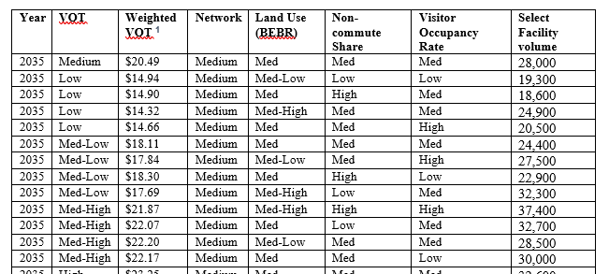
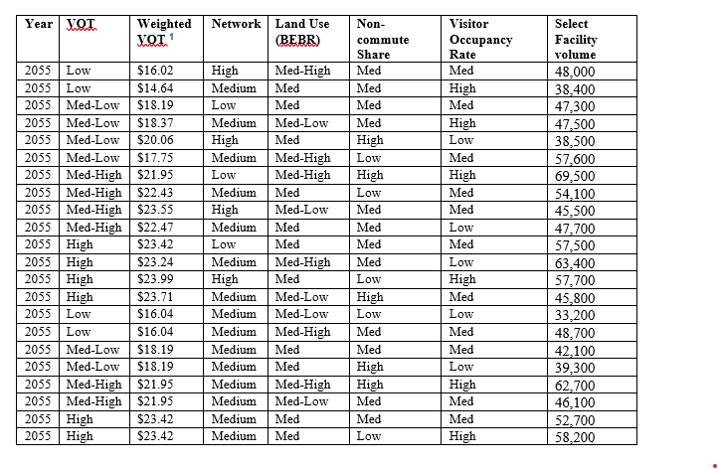
Model Runs for Estimation of Response Surface Mode
An orthogonal fractional factorial design captured main and interaction effects across five uncertainty drivers (VOT, network investment, land use, non-commute share, visitor occupancy). Two forecast years (2035, 2055) plus replications and extensions yielded 42 total simulations, balancing computational efficiency with robust estimation of uncertainty impacts.
A single corridor facility was selected as the dependent variable due to its sensitivity to all key drivers of uncertainty (VOT, land use, network, WFH, visitor occupancy). Corridor-level volumes were extracted from model outputs, and this facility provided a representative link to estimate the response surface model.

Slide 10
Response Surface Model Estimation
 | Coefficients | Standard Error | t-statistics | P>|t|
const | 5.94 | 0.28 | 20.9 | 0
Future_YR | 0.25 | 0.04 | 6.25 | 0
Network_High | -0.06 | 0.04 | -1.5 | 0.15
Network_Low | 0.09 | 0.04 | 2.19 | 0.04
POPEMPAVG | 1.28 | 0.14 | 8.84 | 0
Non_commute_Share | -0.12 | 0.04 | -3.40 | 0.002
Visitor_Occupancy_Rate | 0.25 | 0.06 | 4.04 | 0
wt_VOT | 0.9 | 0.07 | 13.58 | 0
Results Interpretations
Built from 42 experimental runs of TSM-NextGen with varying inputs
Regression explained corridor demand with R² = 0.964.
Strongest drivers: regional population & employment, and weighted VOT.
Other effects:
Higher visitor occupancy and future year → ↑ demand
Higher non-commute share → ↓ demand
Network investment shifts demand across facilities (less demand with more competing capacity).

Slide 11
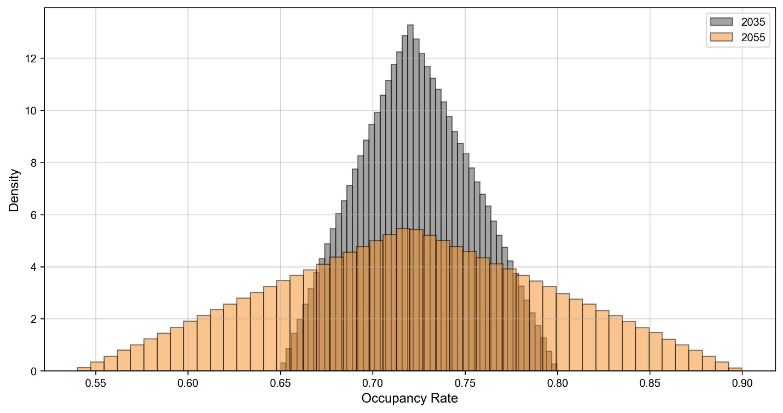
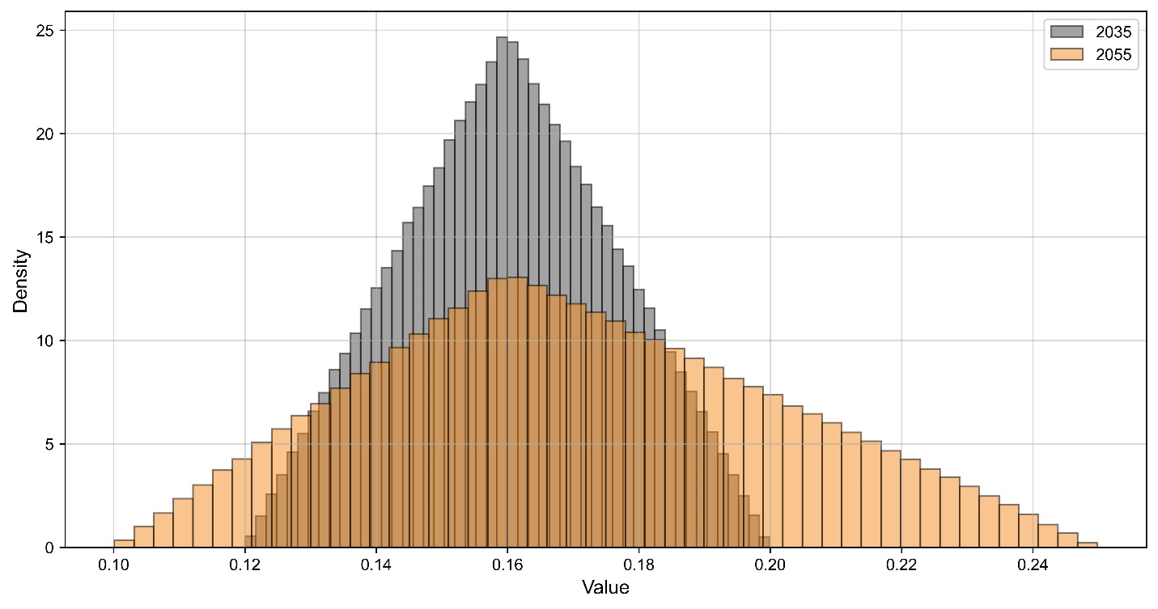

Monte Carlo Simulation I: Variables Probability Distribution
Simulation Set-up (Jupyter Notebook)
Uncertainty was quantified using a Monte Carlo simulation (1M samples, split 2035/2055), with input variables assigned probability distributions based on empirical data and expert judgment.
Future Year: 50% 2035, 50% 2055
Non-Commute Share: Triangular; 2035 range 0.12–0.20 (mode 0.16); 2055 range 0.10–0.25 (mode 0.16)
Visitor Occupancy: Triangular; 2035 range 0.65–0.80 (mode 0.72); 2055 range 0.54–0.90
Visitor Occupancy Rates
Non-commute Share
Notes:
Make it more clear that in order to apply the response surface model, we need to select each variable from a distribution, we assume each distribution is independent, and we assume the functional form, average, and min\max values for each variable’s distribution using judgement.

Slide 12
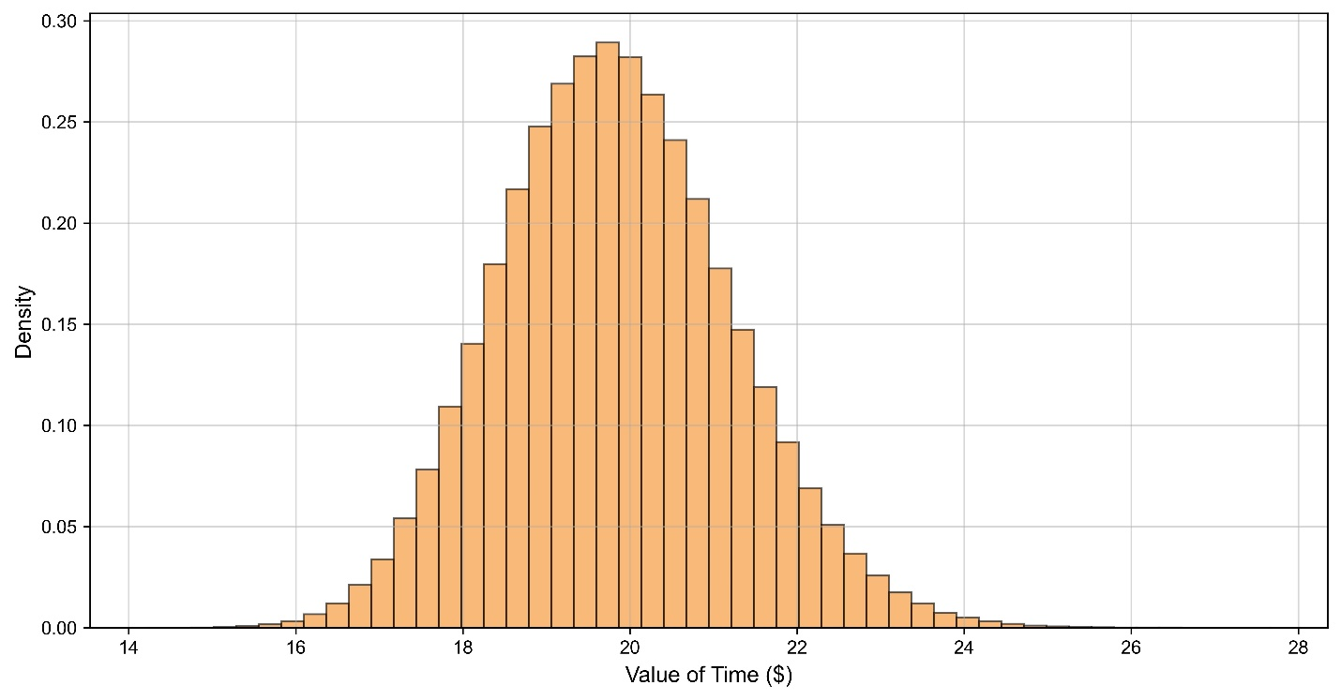
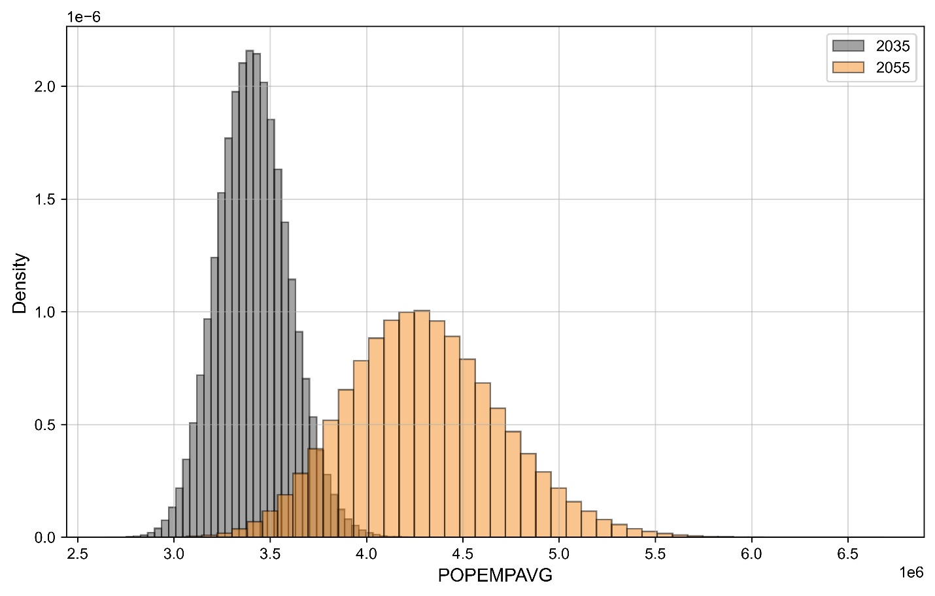
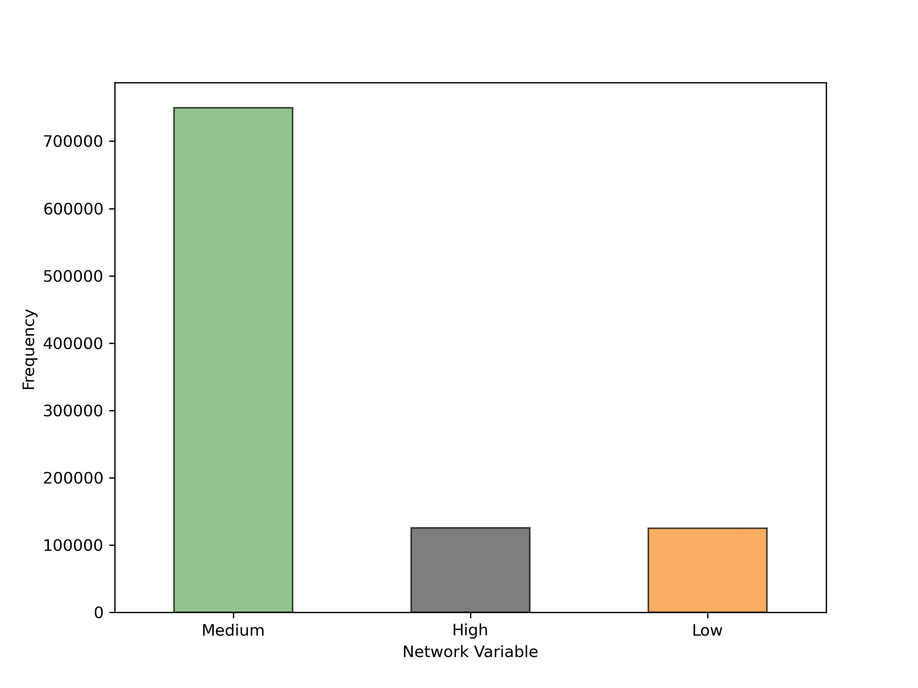
Monte Carlo Simulation II: Variables Probability Distribution
Simulation Set-up (Jupyter Notebook)
VOT & Network Investment
Land Use (POPEMPAVG): Truncated log-normal, based on BEBR bounds with tail risk included
Value of Time: Log-normal, mean $19.83/hr, CV = 0.07
Network Investment: 2035 fixed at Medium; 2055 split: 50% Medium, 25% Low, 25% High
Population + Employment

Slide 13
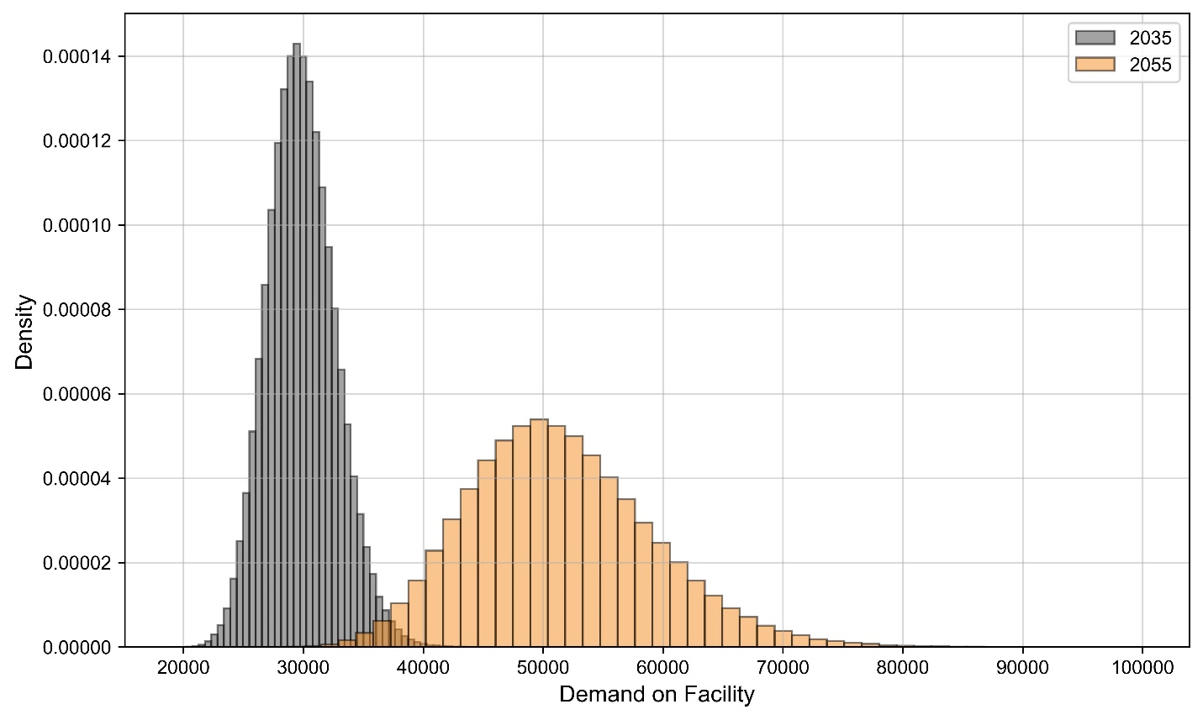
Monte Carlo Simulation III: Results for Subject Facility
2035: AADT range 26k–33.5k (P90/P50 = 0.89)
2055: AADT range 42k–61.5k (P90/P50 = 0.83)
Wider ranges and lower ratios in 2055 indicate greater dispersion and uncertainty, highlighting the importance of accounting for long-term behavioral and structural shifts.
Monte Carlo Simulation Results on Probability of Achieving
Percentiles of Facility Volume | Probability of Achieving | 2035 | 2055
10th Percentile | P90 | 26,400 | 42,100
20th Percentile | P80 | 27,500 | 44,900
30th Percentile | P70 | 28,300 | 47,000
40th Percentile | P60 | 29,000 | 49,000
50th Percentile | P50 | 29,700 | 50,800
60th Percentile | P40 | 30,500 | 52,800
70th Percentile | P30 | 31,300 | 54,900
80th Percentile | P20 | 32,200 | 57,600
90th Percentile | P10 | 33,600 | 61,500

Slide 14
Findings and Takeaways
Uncertainty matters: Long-range forecasts are highly sensitive to behavioral and structural shifts.
Flexible work & visitor demand are major new drivers of variability in travel patterns.
Our framework is efficient: Fractional factorial + response surface modeling reduces computational burden while capturing main and interaction effects.
Probabilistic forecasts (via Monte Carlo) provide confidence intervals, not just point estimates.
Risk grows over time: Forecast ranges widen significantly by 2055, underscoring the need for flexible planning.
Practical value: Agencies can use this approach for revenue risk analysis, financial feasibility, and stress-testing policy-relevant futures.

Slide 15


Acknowledgment
This work was supported by the Florida Turnpike Enterprise (FTE) as part of the 2024 Florida Turnpike State Model (TSM) update.
Collaboration: Framework developed by RSG in close partnership with FTE staff.
Key Contributors:
FTE: Amar Sarvepalli, Cesar Segovia (R&U variables)
RSG
AECOM

Slide 16


Thank you
NOTE
Bishoy Kelleny, Ph.D.
Consultant
bishoy.kelleny@rsginc.com

